Slide 1


01
CAR DIAGNOSTIC SYSTEM:
Software Design
presented by Group 21
Angi Atangwa
Av’Nyehbeuhkonh Ezekiel
Beng Dze
Jong Turkson
Nyuyesemo Calglain
Course Instructor: Dr Nkemeni Valery

Slide 2


AGENDA
02
Car Fault Diagnostic system:
UML designs
Objective of the Car Fault Diagnostic App
Overview of UML Designs
Key UML Diagrams
Conclusion

Slide 3


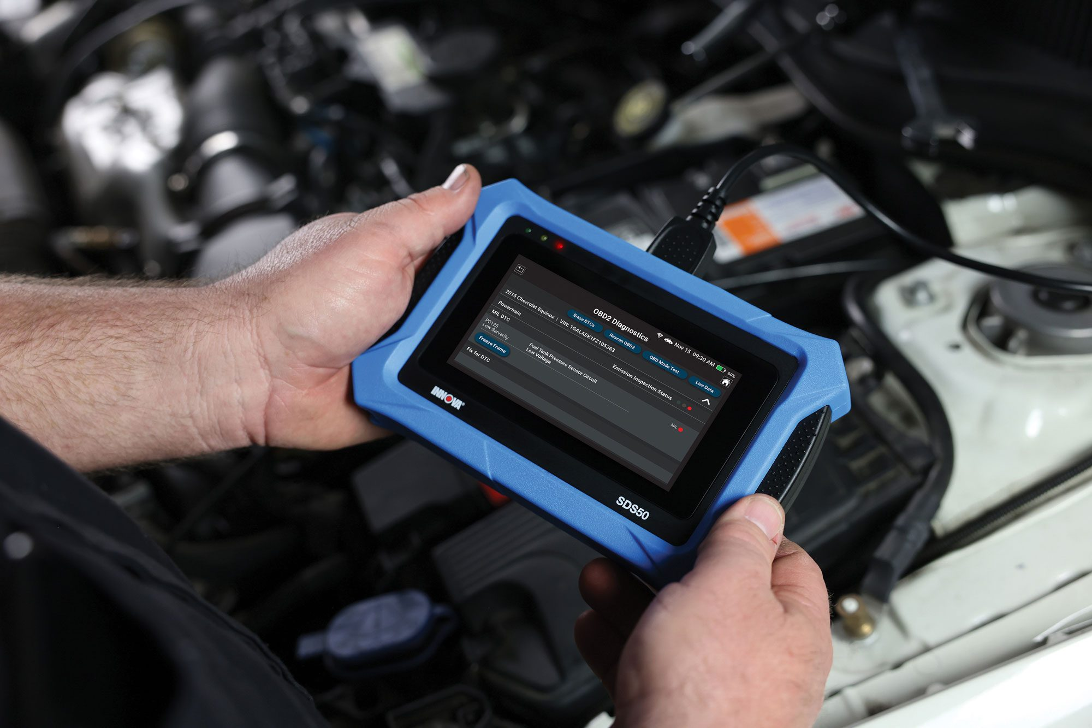
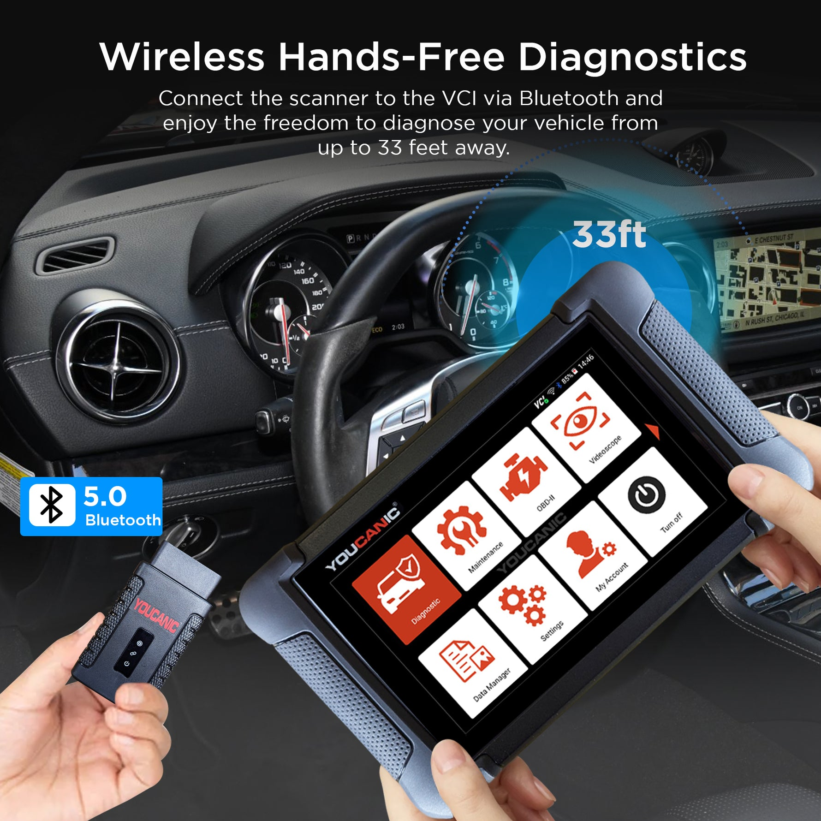
03
System Overview
Problem:
Users struggle with interpreting dashboard lights/engine sounds.
High repair costs due to lack of accessible tools.
Solution:
Mobile app with:
Dashboard light recognition (camera).
Engine sound analysis (ML).
Multilingual support & offline functionality.

Slide 4
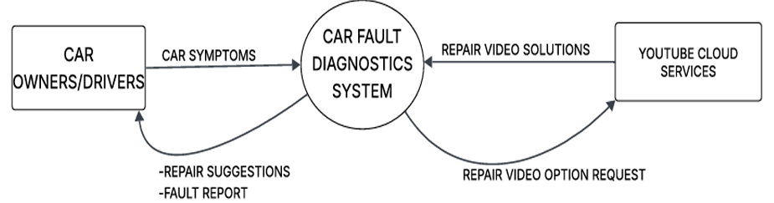
04
System Boundaries & External Interactions
System Core: Car Fault Diagnostics System.
External Entities:
  Car Owners/Drivers
  YouTube Cloud Services
Data Flows:
  Input: Car Symptoms → Output: Fault Report, Repair Suggestions.
  Request: Repair Video Option → Response: Repair Video Solutions.

Slide 5
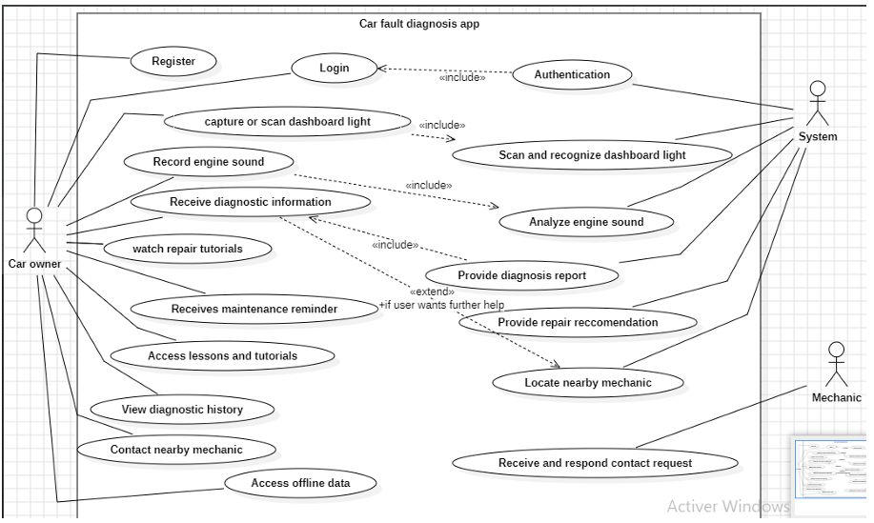
05
Use Case Diagram
Actors:
  Car owner (primary)
  System
  Mechanic
Core Use Cases:
  Scan dashboard light
  Record engine sound
  View tutorials
  Locate mechanics.

Slide 6
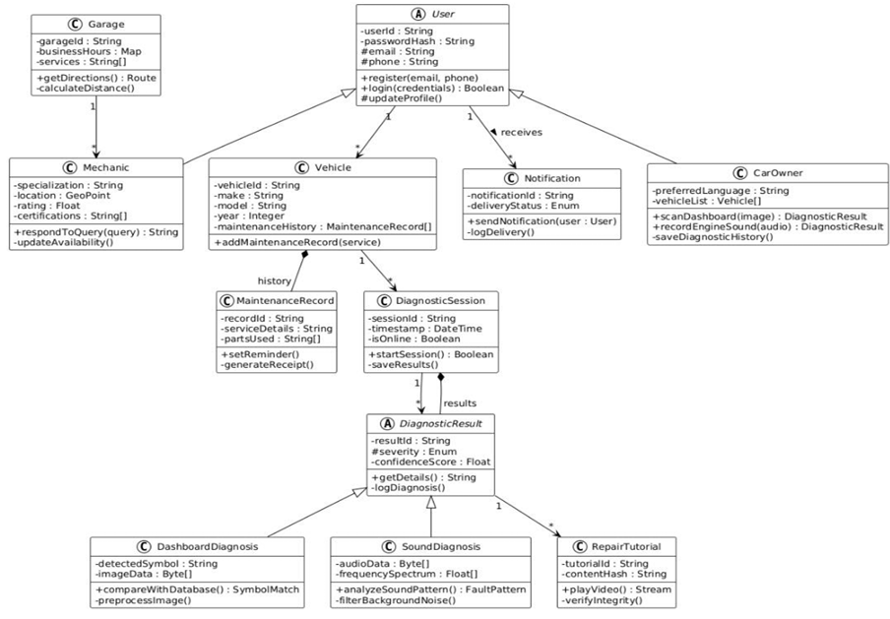
06
System Structure & Key Classes

Slide 7
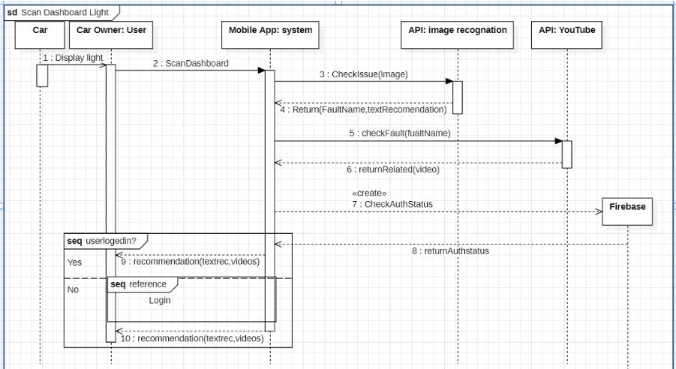
Sequence Diagram (Dashboard Light Scan)
07

Slide 8
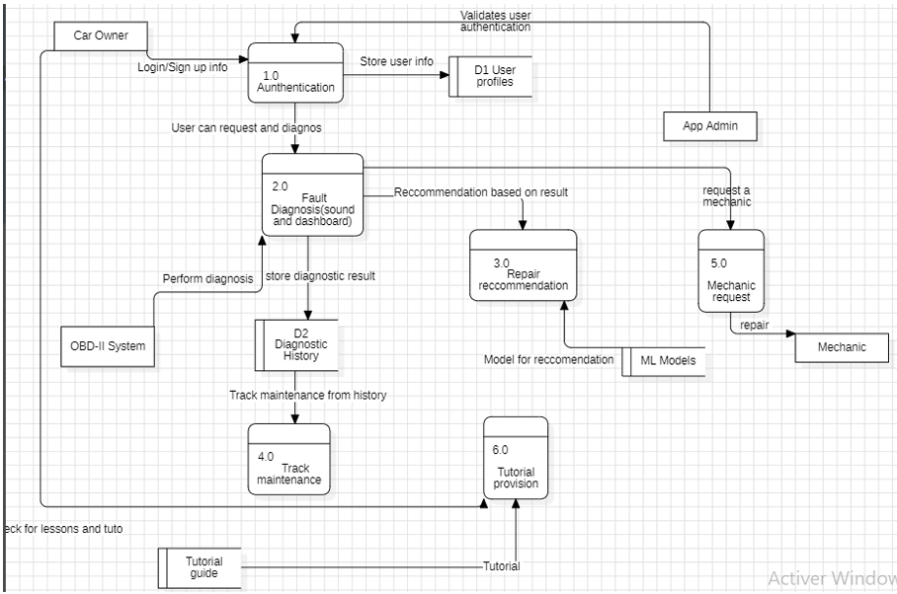
Data Flow diagram
08

Slide 9
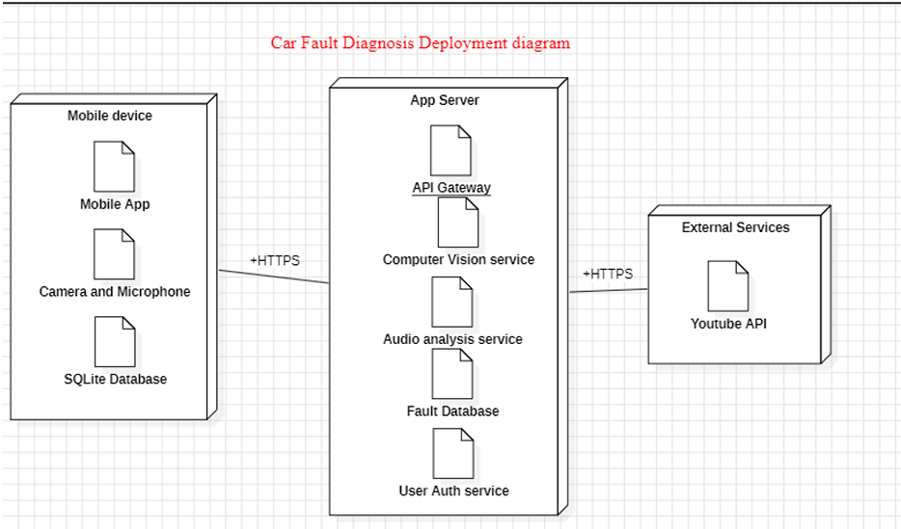
Deployment Diagram
09
Nodes:
Mobile Device
Server
External
Visual: High-level deployment diagram (mobile ↔ server ↔ cloud).

Slide 10
Conclusion
Key Takeaways:
UML designs ensure clarity (use cases, data flow, deployment).
Modular architecture (MVVM) supports scalability

Slide 11

THANK YOU

